Slide 1

MAJOR PROJECT
ON
AUTO MED
(AUTO GARAGE MANAGEMENT SYSTEM)
Submitted By:- Akash Singh,
Prem Arpan Khalkho,
Tania Sahani,
M.D Firdoush Malik
Session:- 2019-2023
Guided By:-
Mrs. Sushma Rath
Asst. Professor & Guide Dept. of CSE&A

Slide 2
Contents:-
Introduction
Problem statement
Proposed Solution
Objectives
Features
ER diagram
System Architecture
Block diagram
Use Case diagram
UI screenshots
Conclusion
Future scope
References
29/04/2023
1

Slide 3
Introduction
Automed is an auto garage management software crafted to help auto garages to manage their daily activities. Packed with features, Automed will help garage increase efficiency and get more work done.
29/04/2023
2

Slide 4
Problem statement
Currently in garages, the workers aren't distributed properly. There isn’t any systematic approach of storing data which ends up in loss of knowledge. There are many cases where providing efficient service to every vehicle user may be a challenging task for garages. The quality at which work is completed isn't up to mark.
29/04/2023
3

Slide 5
PROPOSED SOLUTION
Developing a garage management system that will allow:
Garage bookings & inventories and streamline garage operations.
Rollout discount offers.
Mechanics to send automatic car service status & booking status via emails & SMS.
Mechanics to recommend certain services or parts replacement to client supported car history.
Garage owners to assign jobs and supply rule based access of system of varied resources of garage.
29/04/2023
4

Slide 6
Objectives:
Efficient scheduling
Effective inventory management
Improved customer management
Better financial management
Enhanced reporting and analysis
29/04/2023
5

Slide 7
Features
Billing and Invoicing
Inventory management
Booking In
Reporting and analytics
Overview
Task Manager
Suppliers Manager
Customer Relationship manager(CRM)
Payment History
Marketing & Bulk SMS
Staff management
Settings
29/04/2023
6

Slide 8
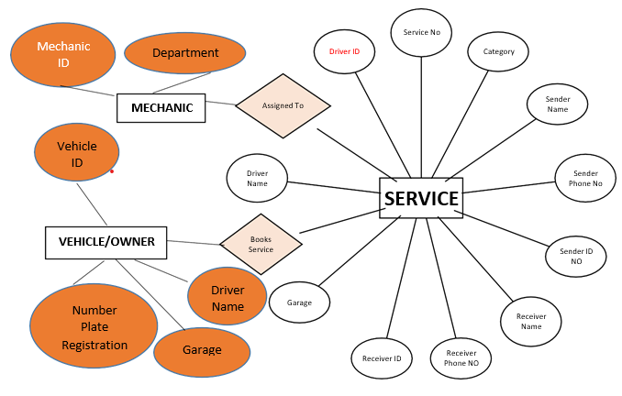
E-R diagram
Fig. ER diagram
29/04/2023
7

Slide 9
System Architecture
The system architecture may include the following modules:
User Interface
Database
Booking System
Inventory Management
Billing and Payment
Reporting and Analytics
29/04/2023
8

Slide 10
Block diagram
Garage login/register
Assign
mechanic
Add costumer
Edit profile
Add vehicle
Printing invoice
Generate invoice
Add staff/ mechanic
Inventory management
Delete staff/mechanic
Fig. Block diagram
29/04/2023
9

Slide 11
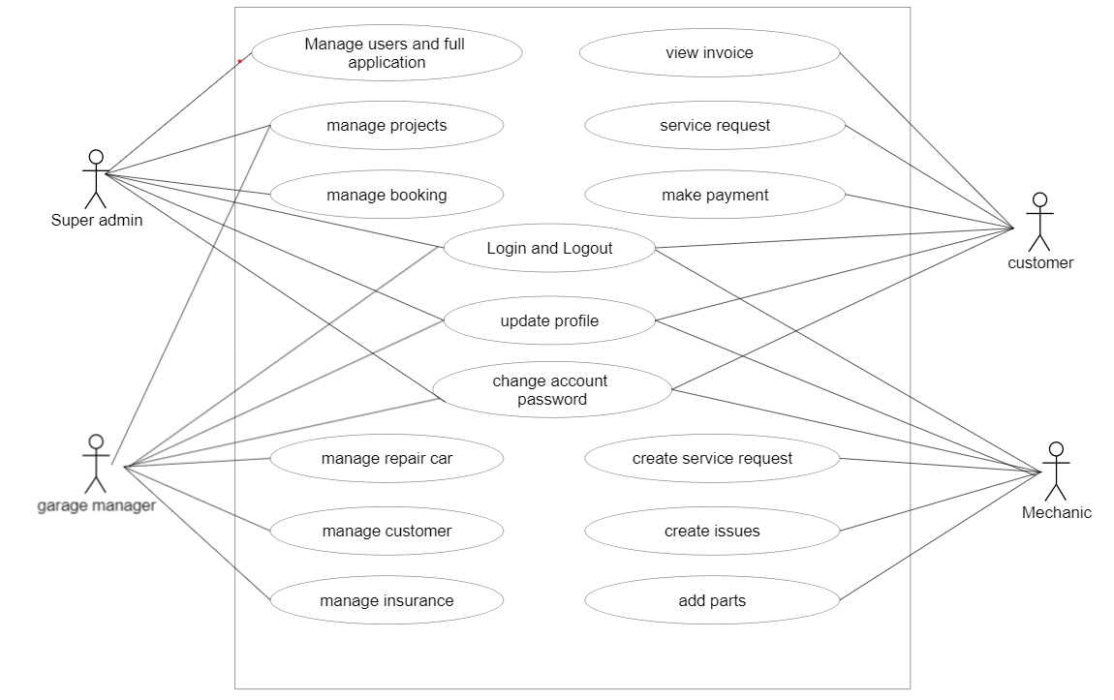
Use Case diagram
AUTO GARAGE MANAGEMENT SYSTEM
Fig. Use Case diagram
29/04/2023
10

Slide 12
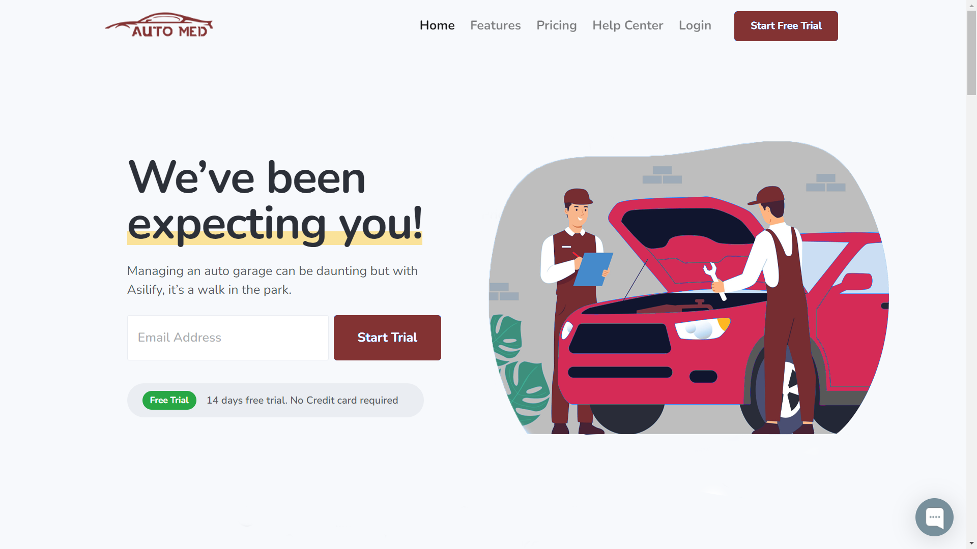
UI screenshots: Home page
29/04/2023
11

Slide 13
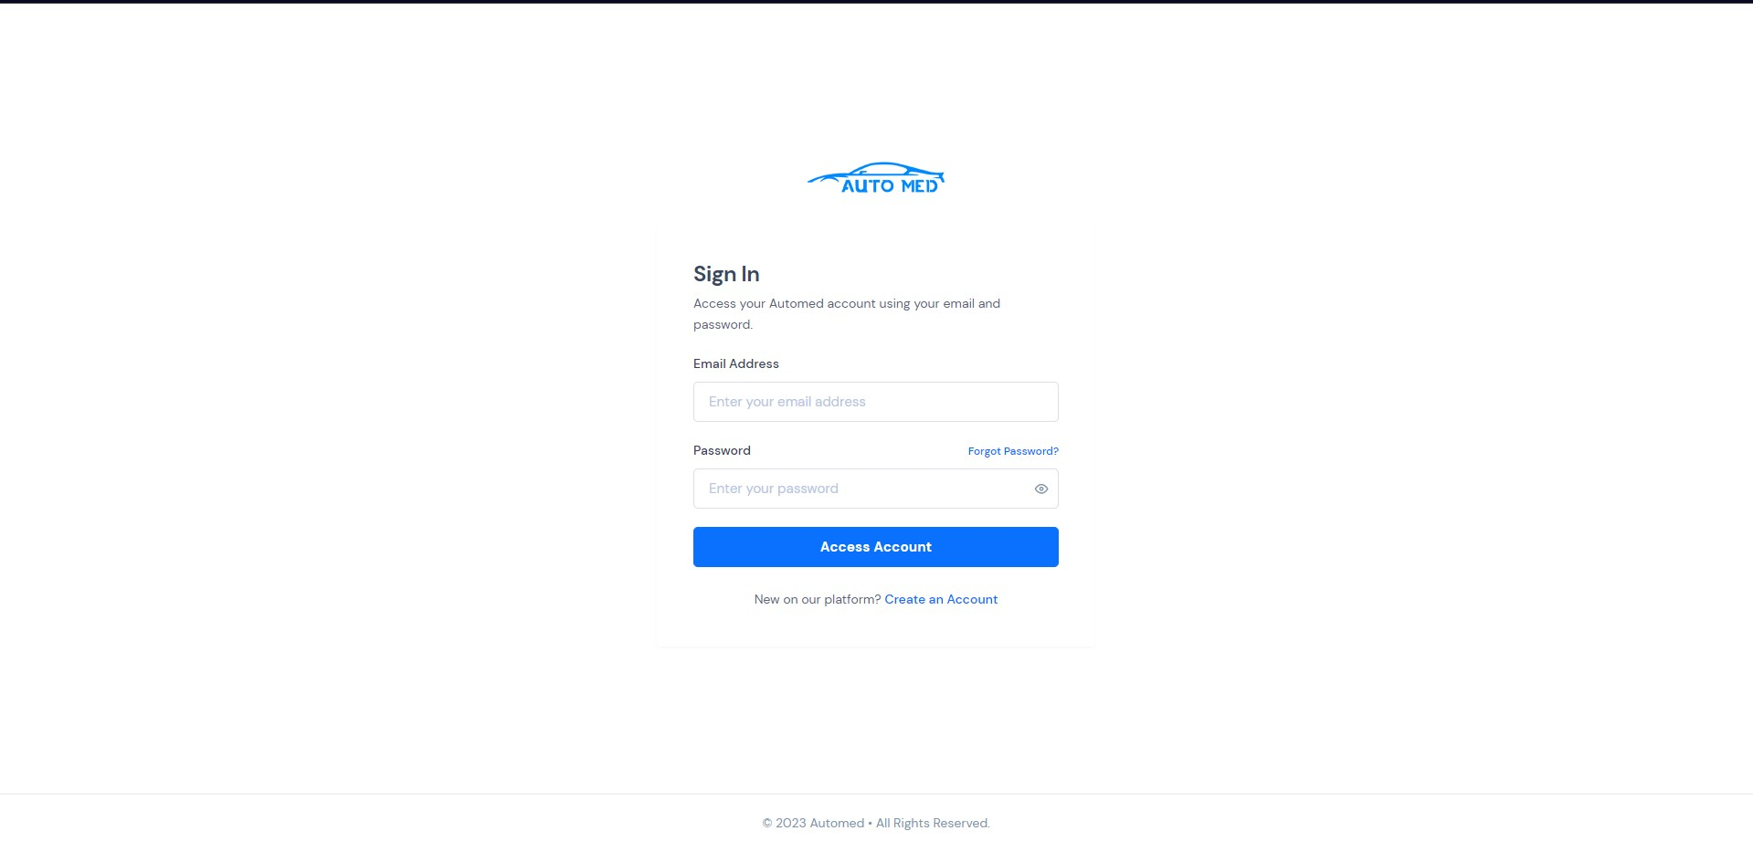
Login page
29/04/2023
12

Slide 14

Registration page
29/04/2023
13

Slide 15
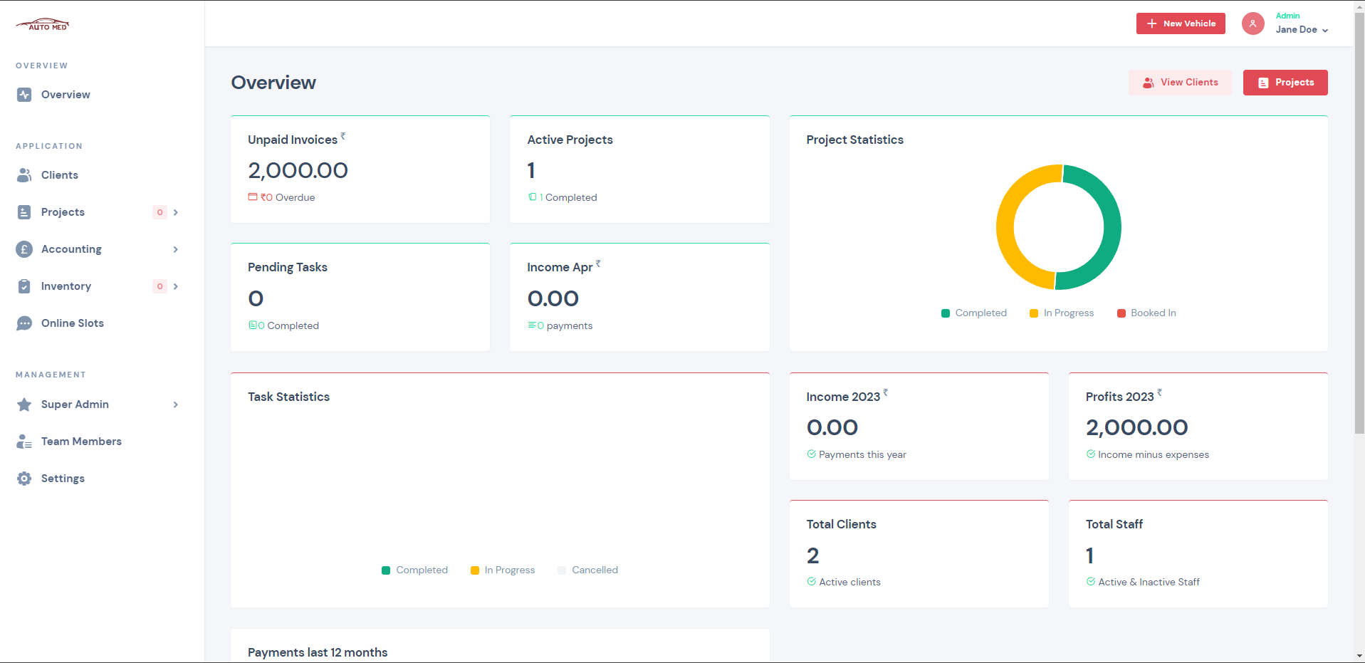
Admin overview
29/04/2023
14

Slide 16
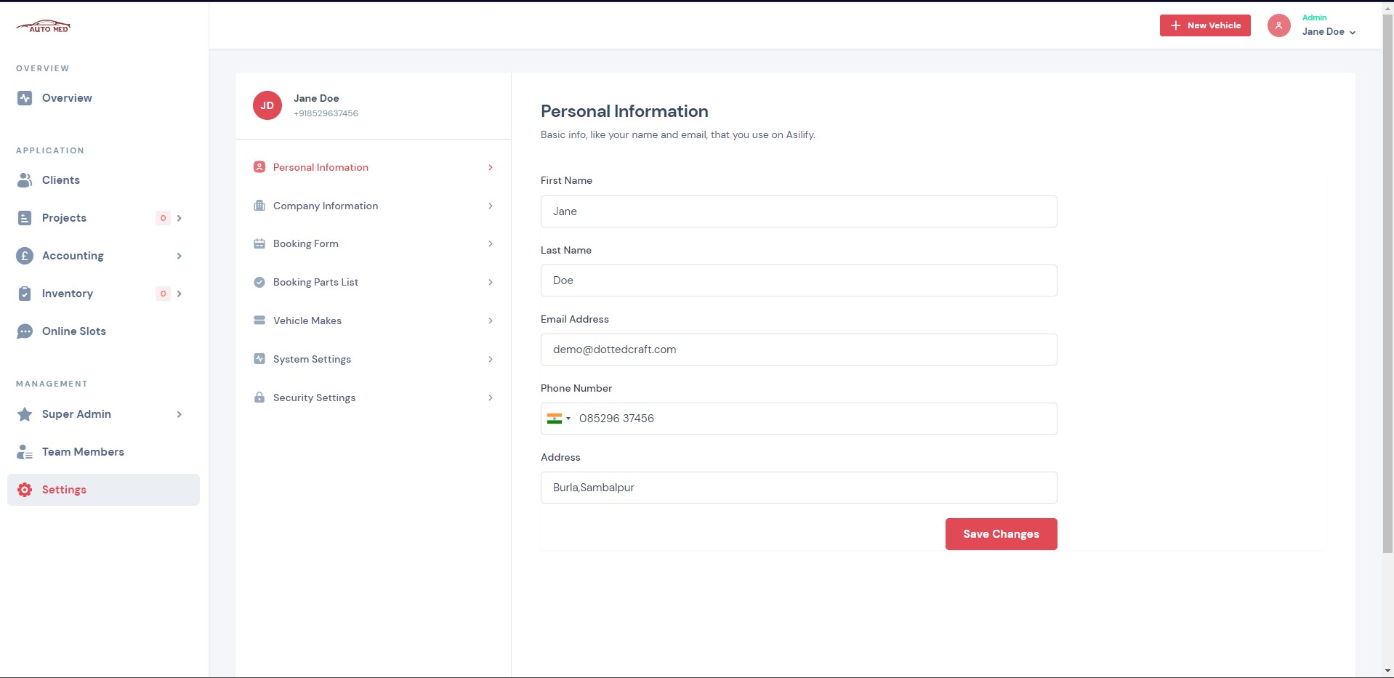
Profile page
29/04/2023
15

Slide 17
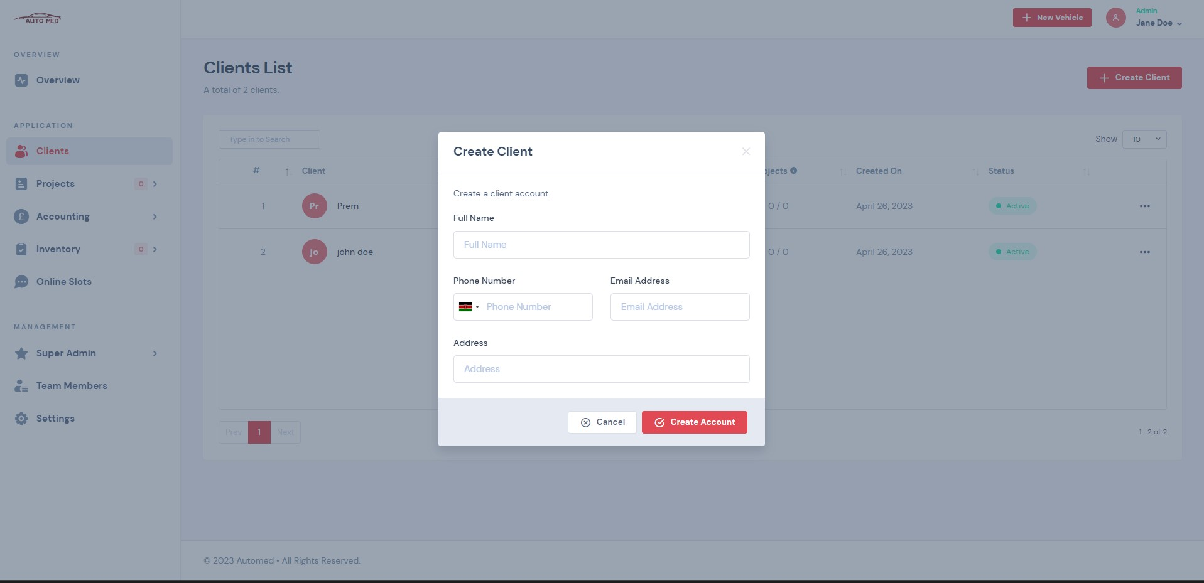
Add new client page
29/04/2023
16

Slide 18
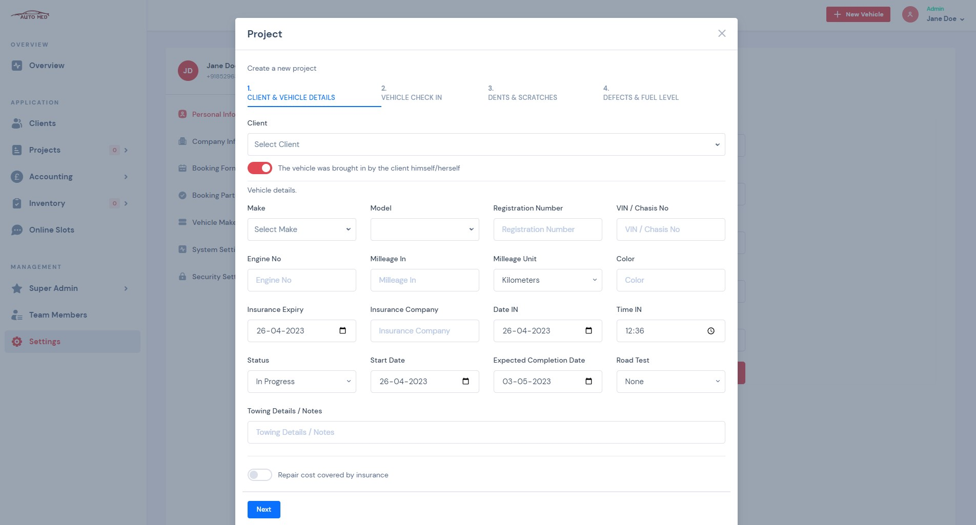
Add new project page
29/04/2023
17

Slide 19
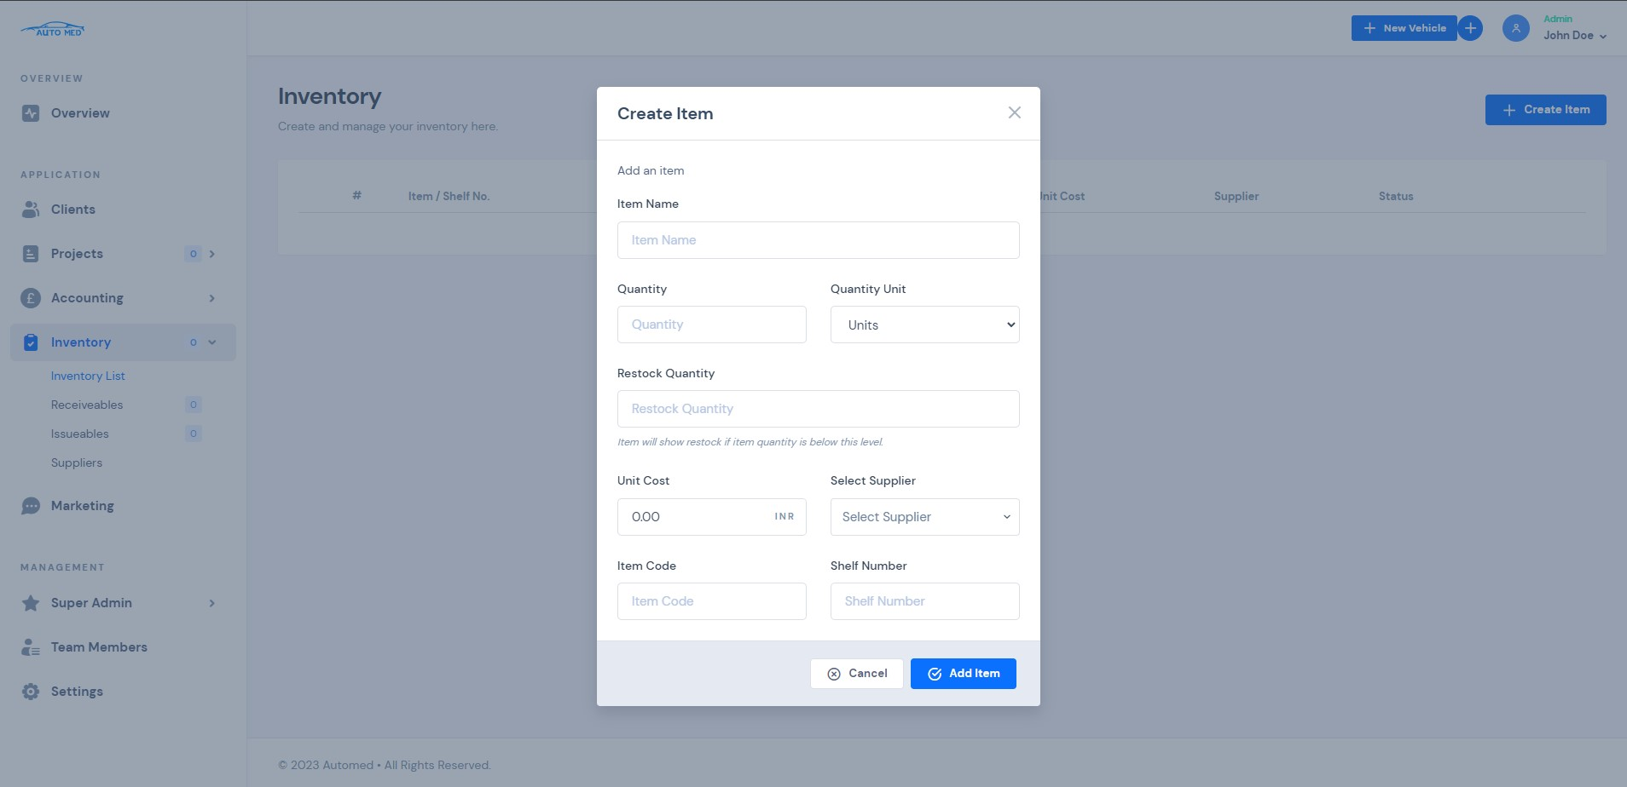
Inventory management page
29/04/2023
18

Slide 20
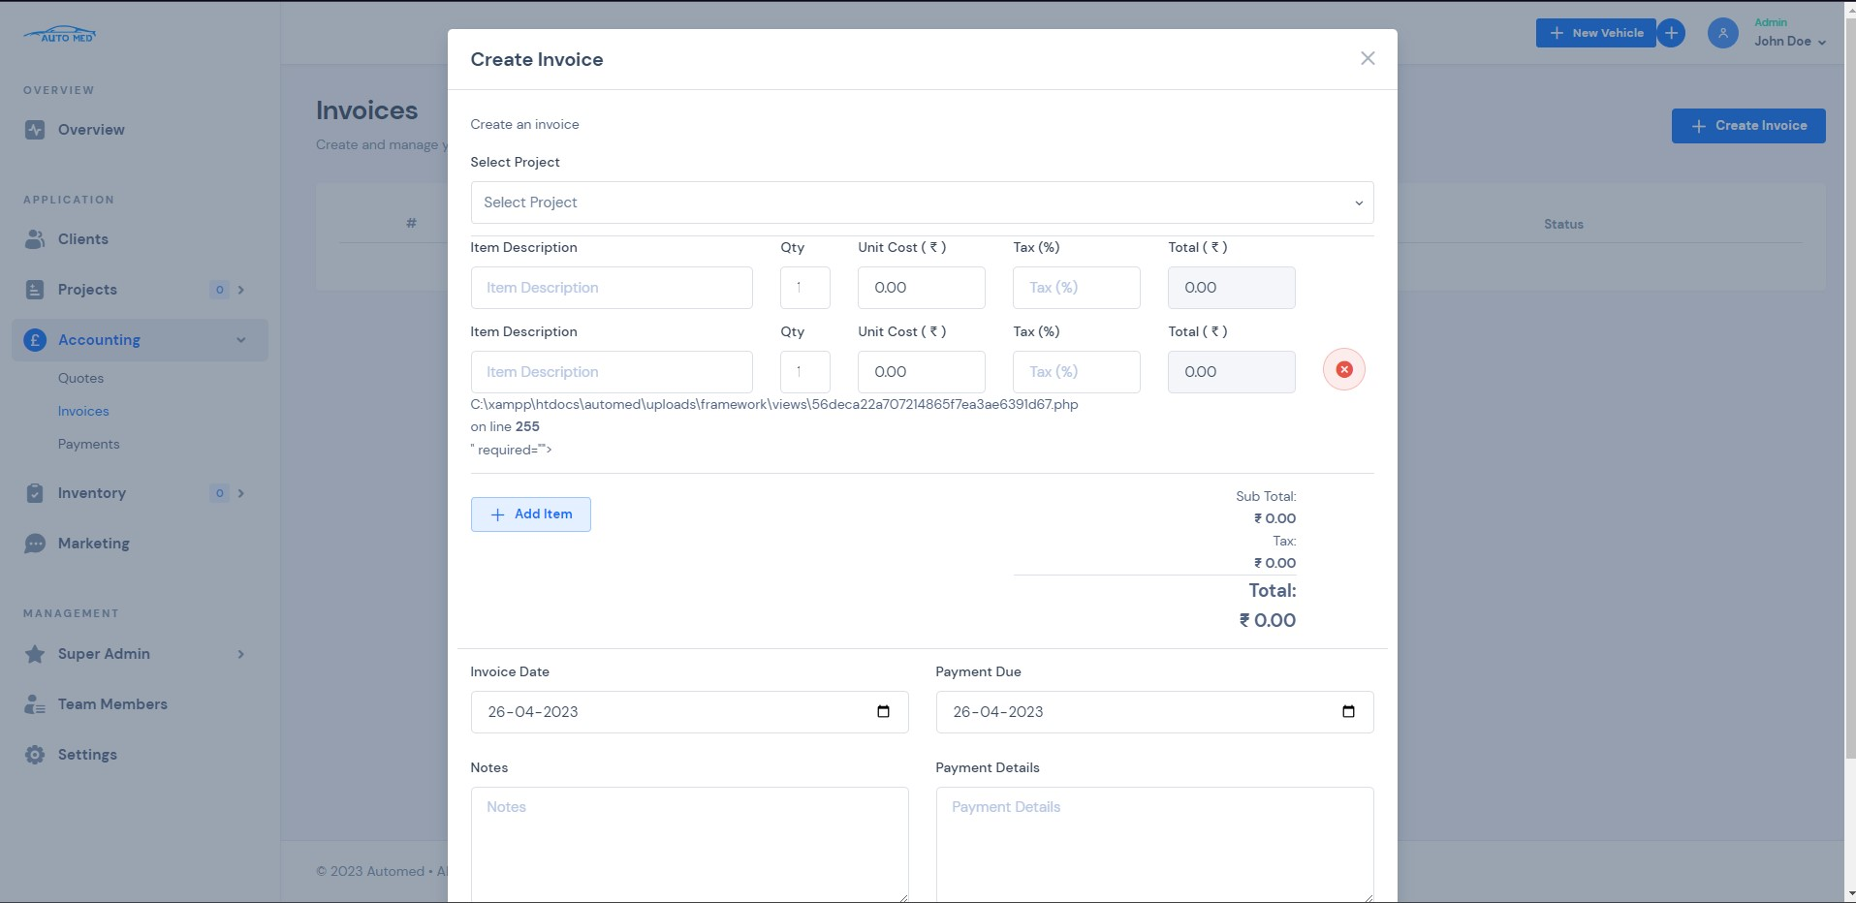
Invoice generation page
29/04/2023
19

Slide 21
Conclusion
In conclusion, a garage management system is an essential tool for garage owners looking to streamline their operations and improve efficiency.
The system offers several benefits, including appointment scheduling, inventory management, billing and invoicing, and customer management, making it a must-have for any modern garage.
29/04/2023
20

Slide 22
Future Scope
Integration with IoT: The garage management system can be integrated with Internet of Things (IoT) devices to improve automation and control.
Mobile Application: Developing a mobile application for the garage management system can help the users access the system and control it remotely.
Data Analytics: Analytics can also provide insights into customer behavior, preferences, and service history.
Predictive Maintenance
Enhanced Security
Customer Experience
29/04/2023
21

Slide 23
References
“Hanamant B. Sale , Dharmendra Bari , TanayDalvi , Yash Pandey”, “Online ManagementSystem for Automobile Services”, International Journal of Engineering Science and Computing(IJESC),Volume8IssueNo.02,March-2018.
“Prof.ShilpaChavanSaketAdhav,RushikeshGujar, Mayur Jadhav, Tushar Limbore”,“Automobile Service Center Management System”,InternationalJournalofScientificandResearch Publications,Volume4,Issue3,March 2014.
"Garage Management System" by Dhaval Patel, International Journal of Advance Research, Ideas and Innovations in Technology (2017).
"Design and Development of Garage Management System" by P. Srinivasa Rao, S. Sreekanth Reddy, and B. Suresh, International Journal of Innovative Research in Science, Engineering and Technology (2016).
29/04/2023
22

Slide 24
Thank you
29/04/2023
23

